Slide 1

Social Media
Presented by
221LA04011
SMD.ZADEER

Slide 2
Contents:
Introduction
Types of Social Media Platforms
Benefits of Social Media
Challenges of Social Media
Social Media Etiquette
Social Media for Business
Social Media and Mental Health
Social Media Trends
Conclusion
Notes:
Image source: https://biq.cloud/blog/social-media-content-planning/

Slide 3
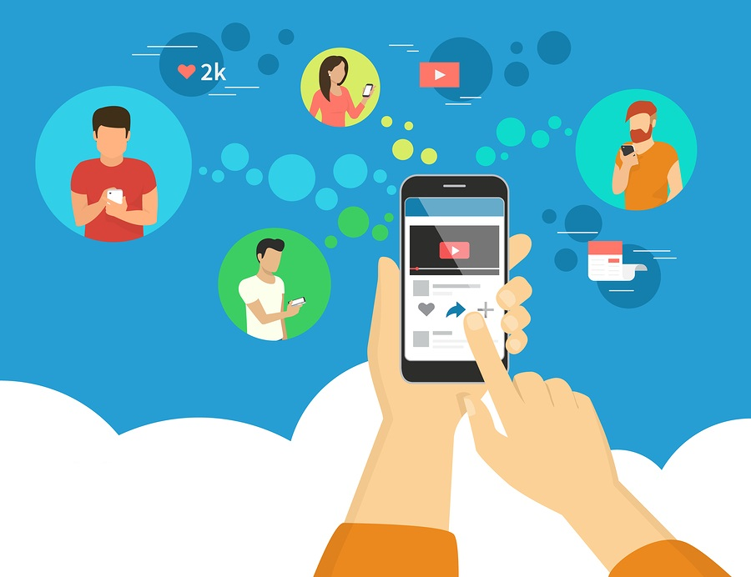
Introduction to Social Media
Social media is a digital platform that allows users to create and share content.
It enables users to connect and interact with others globally.
Social media has revolutionized communication and transformed the way we share information.
Notes:
Image source: https://biq.cloud/blog/social-media-content-planning/

Slide 4
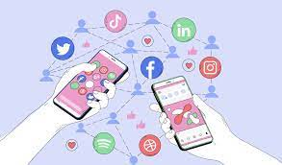
Types of Social Media Platforms
Facebook is the most popular social media platform globally, with billions of users.
Twitter allows users to share short messages, or "tweets," in real-time.
Instagram focuses on visual content, like photos and videos, and has a strong community of influencers.
Notes:
Image source: http://www.socialsamosa.com/2019/03/infographic-most-popular-social-media-platforms-of-2019/

Slide 5
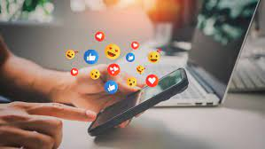
Benefits of Social Media
Social media enhances communication by connecting people worldwide.
It provides a platform for sharing ideas, opinions, and experiences.
It enables businesses to reach a larger audience and promote their products or services.
Notes:
Image source: https://www.reddit.com/r/Infographics/comments/aetxw1/benefits_of_social_media_to_the_rest_of_the_world/

Slide 6
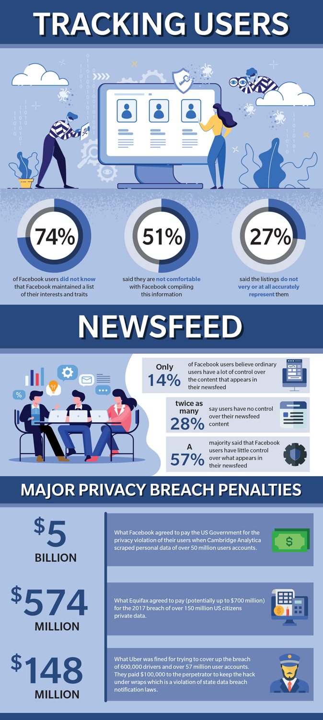
Challenges of Social Media
Privacy concerns arise due to the collection and sharing of personal data.
Cyberbullying and online harassment are prevalent issues on social media.
The spread of misinformation and fake news can negatively impact society.
Notes:
Image source: https://www.latestinfographics.com/__trashed-16/

Slide 7
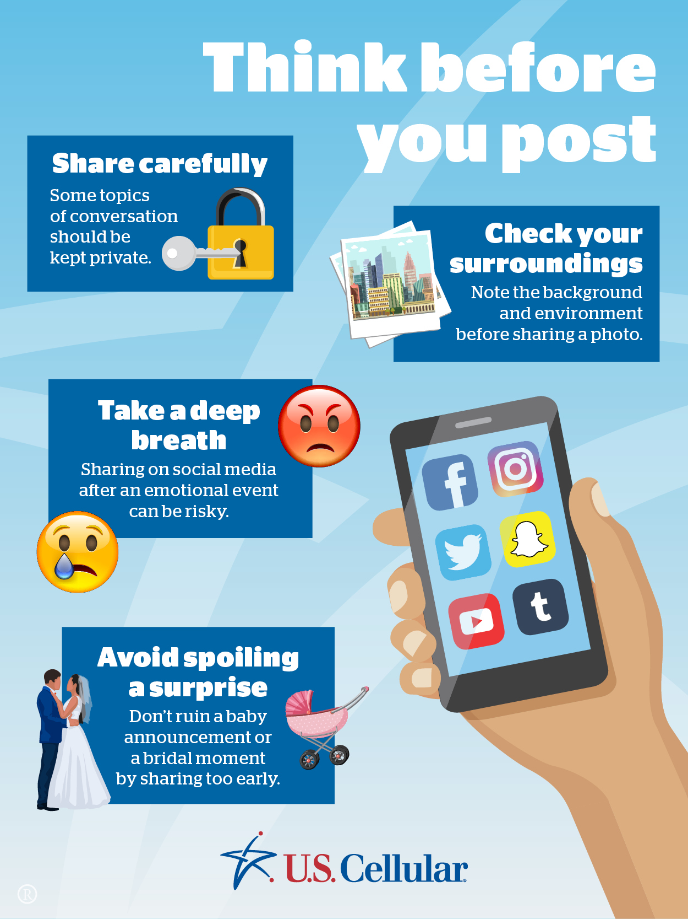
Social Media Etiquette
Be respectful and considerate when interacting with others online.
Think before posting or sharing content to avoid potential negative consequences.
Understand and follow platform-specific guidelines and rules.
Notes:
Image source: https://donnahup.com/social-media-etiquette/

Slide 8
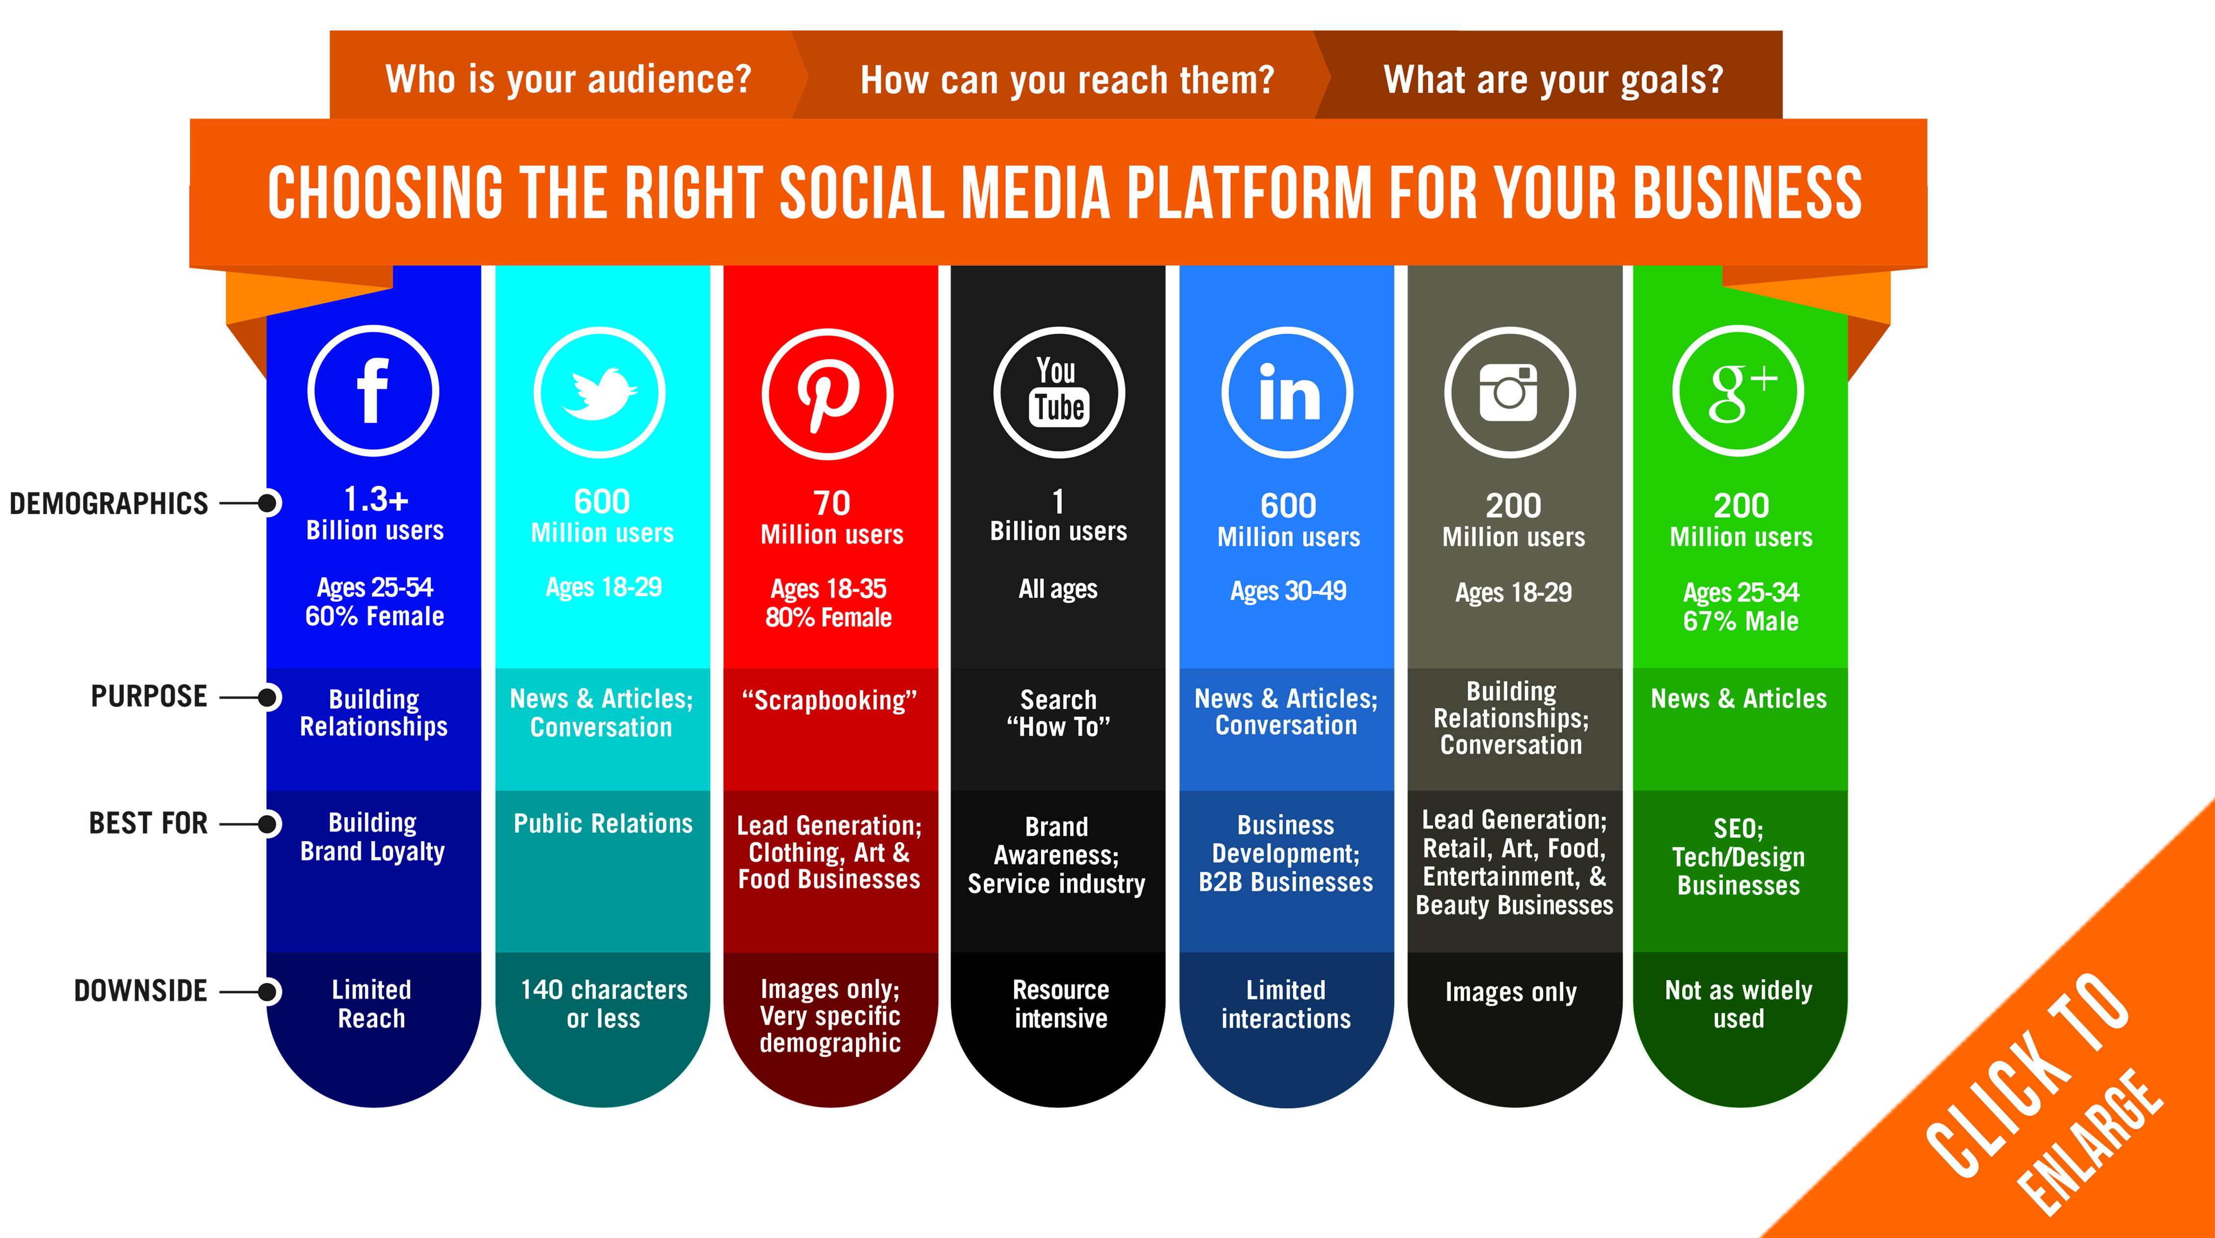
Social Media for Business
Businesses can use social media for brand awareness and customer engagement.
It provides a channel for direct customer feedback and support.
Social media advertising allows businesses to target specific audiences effectively.
Notes:
Image source: http://marketingleap.net/social-media-platform-right-business/

Slide 9
Social Media and Mental Health
Excessive social media use may contribute to feelings of loneliness and depression.
Comparing oneself to others on social media can negatively impact self-esteem.
It is essential to balance social media consumption with real-life interactions.
Notes:
Image source: https://addictionadviceonline.com/how-social-media-affects-our-mental-health/

Slide 10
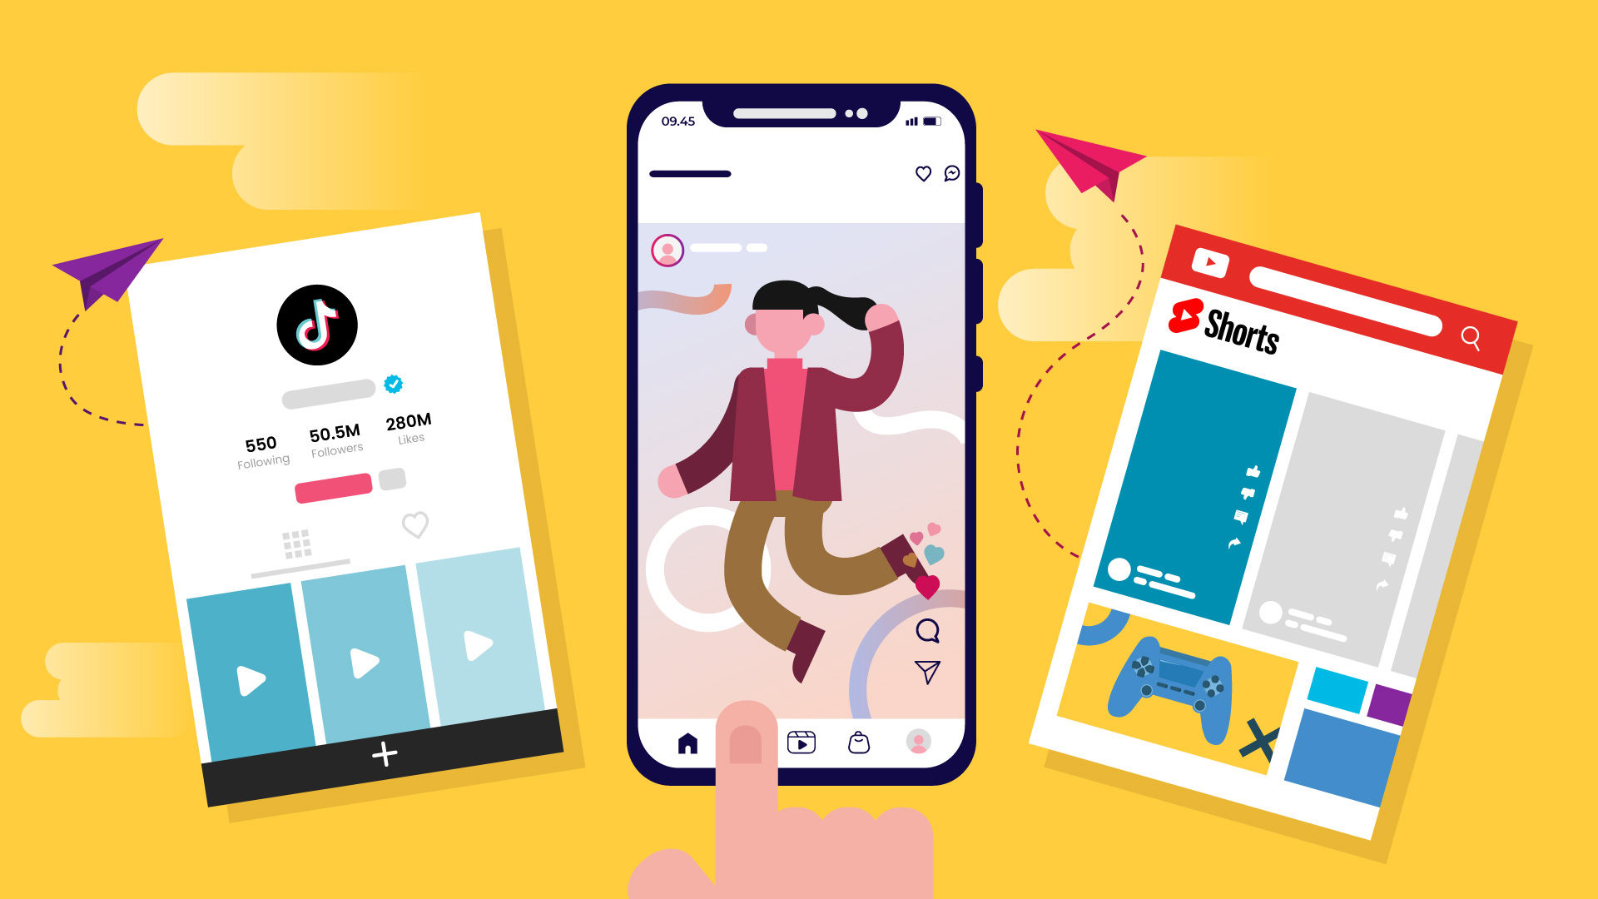
Social Media Trends
Video content, such as live streaming and short-form videos, continues to gain popularity.
Influencer marketing is a growing trend, with brands utilizing popular social media personalities for promotion.
Social commerce is on the rise, with platforms integrating shopping features directly into the user experience.
Notes:
Image source: https://explainerd.com/short-form-video/

Slide 11
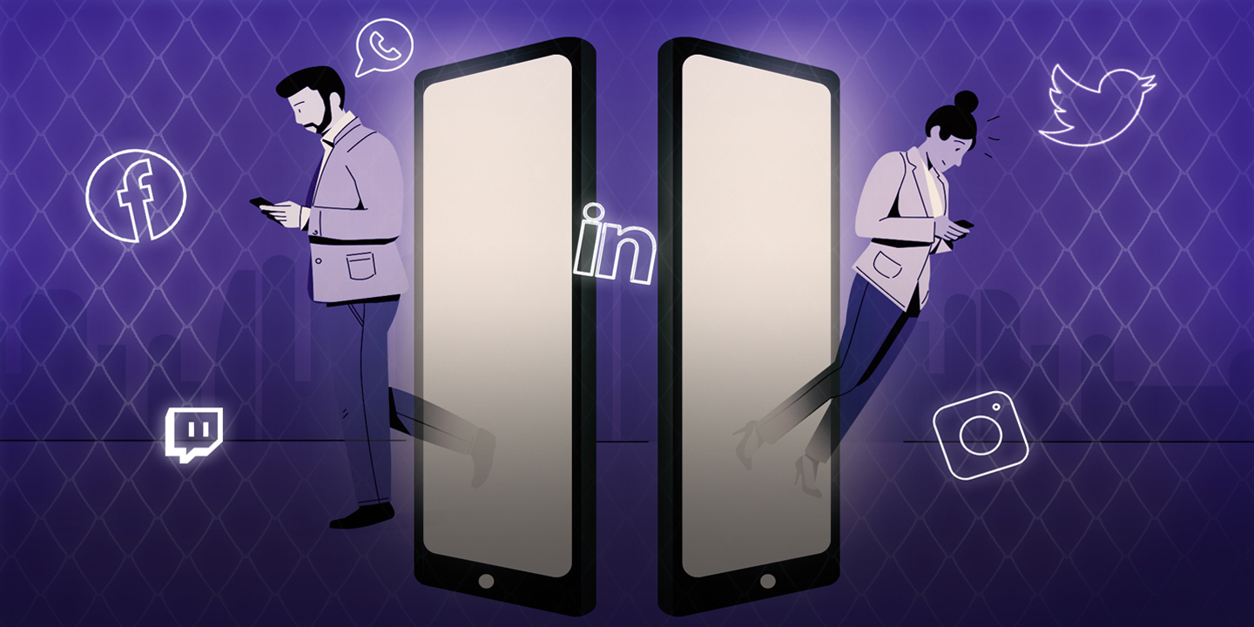
Conclusion
Social media has transformed the way we communicate and connect with others.
It offers numerous benefits, but challenges like privacy and misinformation need to be addressed.
By using social media responsibly, we can harness its power for personal and professional growth.
Notes:
Image source: https://fluvid.com/blog/how-is-technology-changing-the-way-we-communicate/

Slide 12


